Slide 1

Amazon Supply chain management system (scms)
SQL project

Slide 2
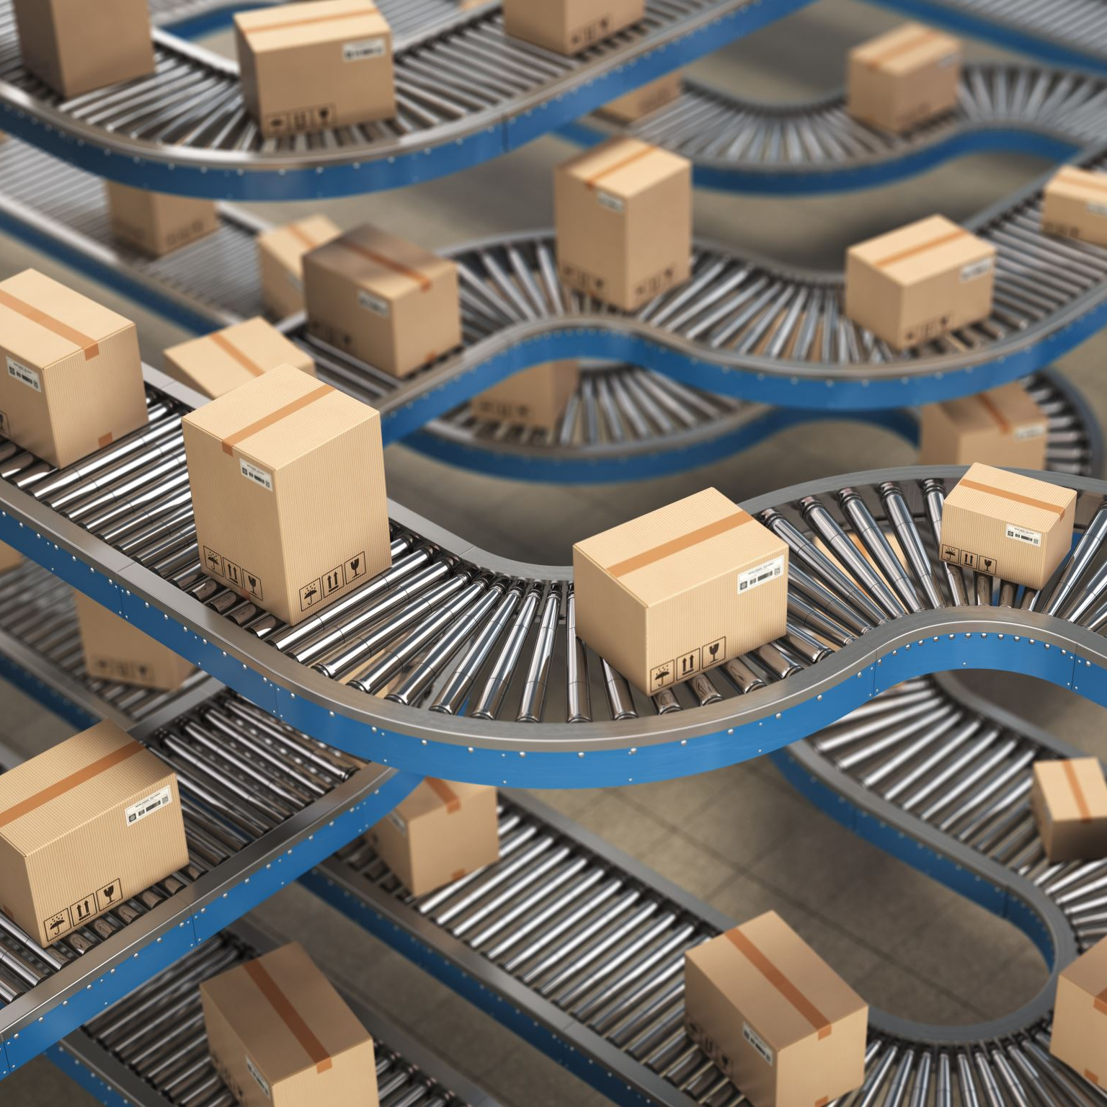
Overview about project
The Amazon-like Supply Chain Management System (SCMS) project is a real-world simulation of a large-scale e-commerce company’s supply chain operations, modeled after Amazon. This system covers the core components of supply chain management, including product catalog management, warehouse operations, supplier relationships, customer orders, and shipment tracking.
Objective
The objective of this project is to create a robust SQL-based relational database that can handle the operations of a multinational corporation like Amazon. This system will:
Efficiently manage products and inventory across various global warehouses.
Track customer orders and order fulfillment.
Monitor suppliers and shipments to ensure timely product replenishment.
Generate insights for business intelligence and decision-making.

Slide 3

1. Products Table
Role: Stores information about all the products available for sale. This table is central to managing inventory, pricing, and categorizing products.
Key Columns:
product_id (Primary Key): Unique identifier for each product.
name: Name of the product (e.g., iPhone 15, Sony PlayStation 5).
category: Category of the product (e.g., Electronics, Home Appliances).
price: The retail price of the product.
stock_level: Current stock available in the inventory across all warehouses.
cost_price: The cost price of the product (used for profit margin calculations).

Slide 4
2. Orders Table
Role: Tracks all customer orders, including order details, status, and total amount. This table is crucial for monitoring customer activity and processing order fulfillment.
Key Columns:
order_id (Primary Key): Unique identifier for each order.
customer_id (Foreign Key): Links to the Customers table to identify which customer placed the order.
order_date: Date when the order was placed.
total_amount: Total value of the order.
order_status: Status of the order (e.g., Pending, Shipped, Delivered, Canceled).

Slide 5
3. Customers Table
Role: Contains information about customers, including their personal details and contact information. It is linked to the Orders table to track the buying patterns and preferences of customers.
Key Columns:
customer_id (Primary Key): Unique identifier for each customer.
name: Customer’s full name.
email: Customer’s email address for contact and notifications.
address: Customer's shipping address for order delivery.

Slide 6
4. Shipments Table
Role: Tracks the shipment of products from suppliers to warehouses or from warehouses to customers. This table is essential for inventory replenishment and order fulfillment.
Key Columns:
shipment_id (Primary Key): Unique identifier for each shipment.
product_id (Foreign Key): Links to the Products table to track which product is being shipped.
warehouse_id (Foreign Key): Links to the Warehouses table to determine the destination of the shipment.
quantity: The number of units being shipped.
shipment_date: Date when the shipment was dispatched.
supplier_id (Foreign Key): Links to the Suppliers table if the shipment is coming from a supplier.

Slide 7
5. Warehouses Table
Role: Stores information about the different warehouses (fulfillment centers) Amazon operates worldwide. This table tracks where products are stored and shipped from.
Key Columns:
warehouse_id (Primary Key): Unique identifier for each warehouse.
name: Name of the warehouse (e.g., Amazon Fulfillment Center JFK8).
location: Geographical location of the warehouse (city, state, or country).
manager: Name of the warehouse manager (optional).

Slide 8
6. Suppliers Table
Role: Contains information about the suppliers who provide products to Amazon. This table tracks supplier performance, including delivery lead times and reliability.
Key Columns:
supplier_id (Primary Key): Unique identifier for each supplier.
name: Supplier's name (e.g., Apple Inc.).
contact_info: Supplier’s contact details (phone, email).
lead_time: Average time it takes for the supplier to deliver products.

Slide 9
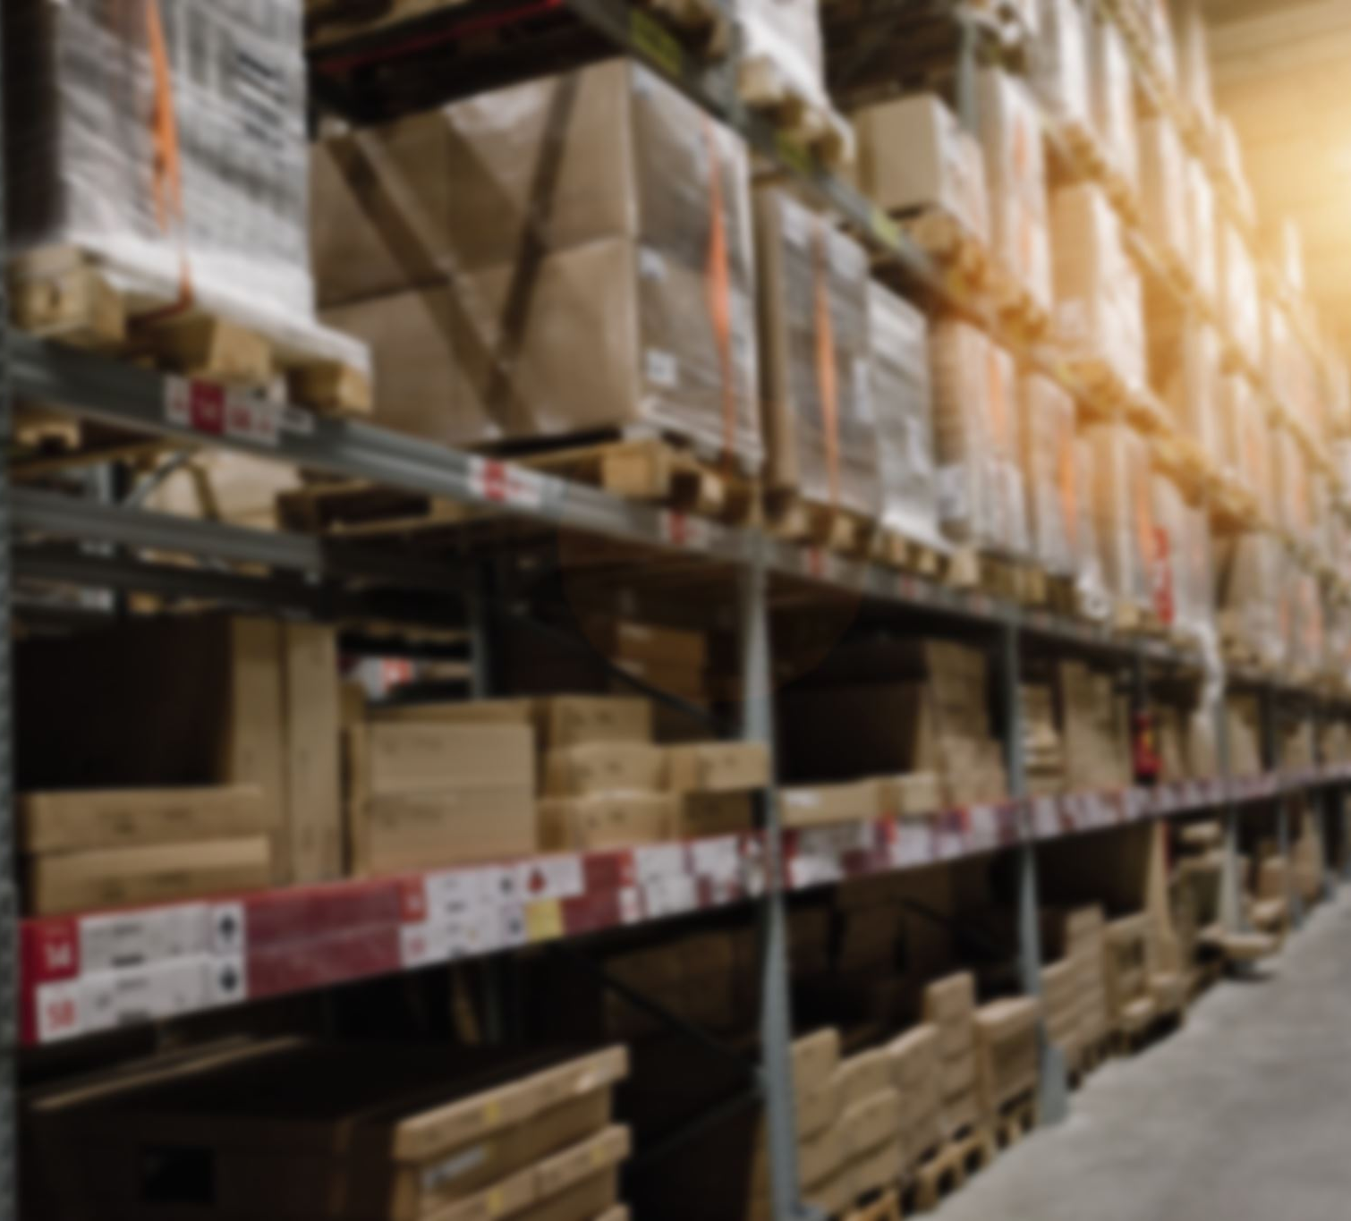
Relationships between Tables
Products ↔ Shipments: Products are moved between suppliers, warehouses, and customers through shipments.
Warehouses ↔ Shipments: Warehouses receive or send shipments of products.
Orders ↔ Customers: Customers place orders, and each order is linked to a customer.
Orders ↔ Shipments: Each order is fulfilled through shipments from the warehouses.
Suppliers ↔ Shipments: Suppliers provide products to warehouses via shipments.

Slide 10
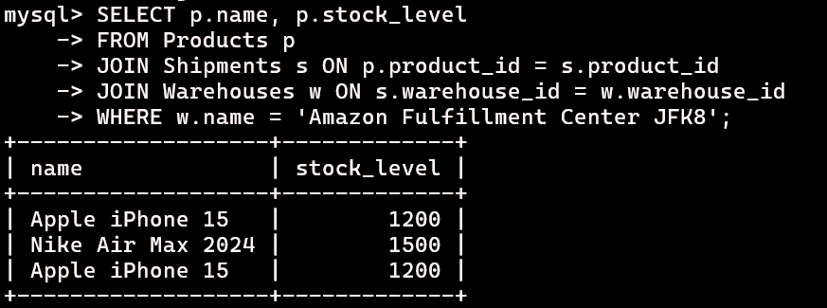
1. Find All Products Available in Staten Island Warehouse:

Slide 11
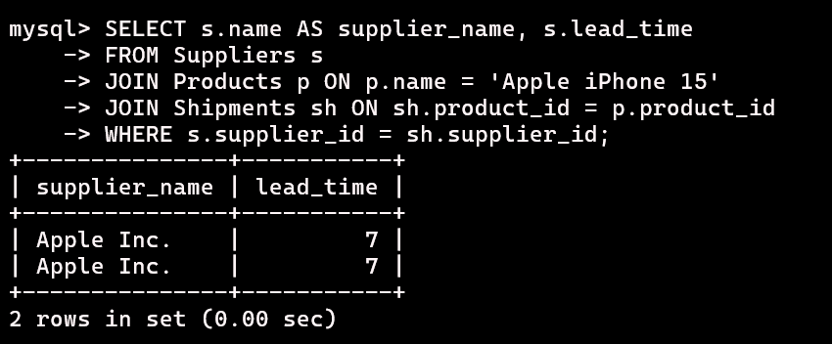
2. Check Supplier Lead Time for iPhone 15:

Slide 12
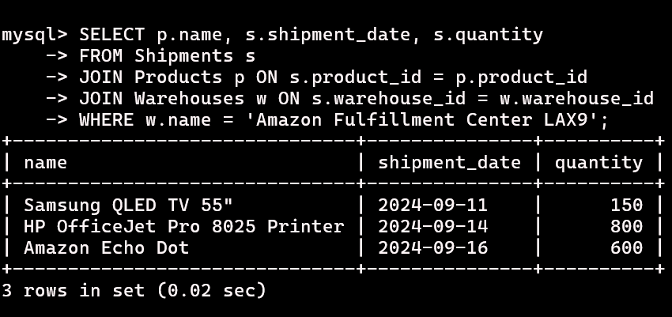
3. Track Shipments to the Los Angeles Fulfillment Center:

Slide 13
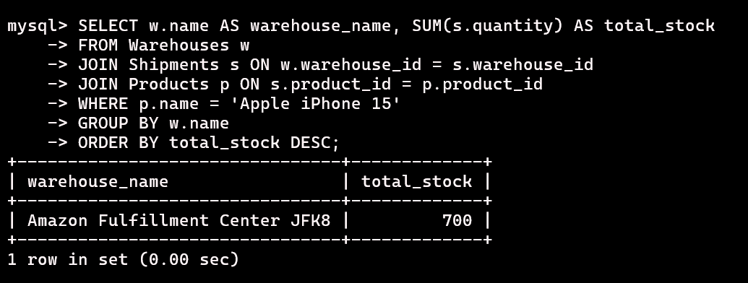
4. Check Which Warehouse has the Most Stock of a Specific Product :

Slide 14
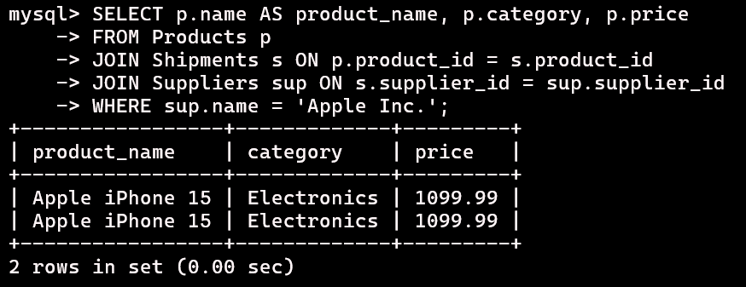
5. Find All Products Supplied by a Specific Supplier :

Slide 15

Conclusion
In this project, we have successfully designed and implemented a comprehensive SQL-based database that simulates the key operations of a large-scale supply chain management system, similar to Amazon. The system effectively handles:
Product management: Including stock tracking, pricing, and category management.
Customer order processing: From order placement to shipment and delivery.
Warehouse management: Monitoring inventory across multiple global fulfillment centers.
Supplier management: Tracking supplier performance and shipment lead times.
Business insights: Generating valuable analytics such as top-selling products, customer trends, and supplier reliability.

Slide 16

Future Scope
Integration with AI/ML algorithms for predictive analytics on stock levels and customer behavior.
Implementation of real-time data streaming to update inventory and order statuses instantly.
Expansion of the system to handle return orders and refund processes.

Slide 17
Thank You
Any question or Feedback?

